Slide 1
Fixed Learning Session – Fractures by Dr. Nirmala Perera
Computer Designing Dr. Udara Senarathne

Slide 2

Objectives…
You should utilize this FLS to achieve the following;
Define a fracture
Identify above injury by its features
Interpret features of causative weapons of injuries
Interpret circumstances of causation of above injuries
Identify medico legal significance of those injuries

Slide 3
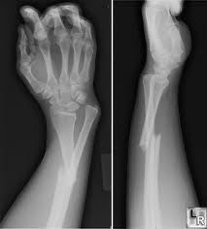
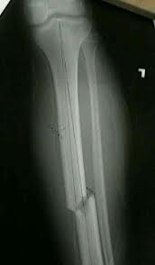
Fractures…
A fracture is a discontinuation to the continuity of a bone.

Slide 4
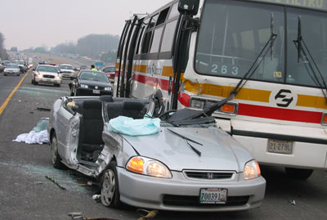
Case scenario…
A patient was admitted to the surgical ward with a history of road traffic accident. This X ray was taken at the PCU.

Slide 5
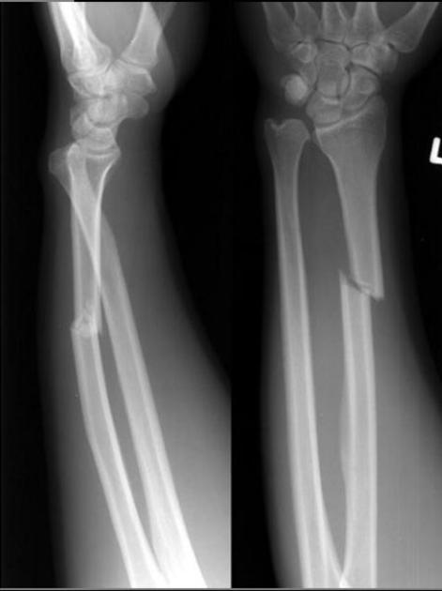
1. This is the AP and lateral X’rays of Left forearm. Describe this X’ray for medico-legal purposes.

Slide 6
1. This is the AP and lateral Xrays of Left forearm. Describe this X’ray for medico-legal purposes.
Displaced, oblique fracture of left radius at distal 1/3rd

Slide 7
2. State the category of hurt you would mention on the Medico legal examination form.

Slide 8
2. State the category of hurt you would mention on the Medico legal examination form.
Grievous
Fractures are grievous injuries under the limb (g ) according to the section 311 of penal code.

Slide 9

Case Scenario…
A 35 year old three wheel driver was brought to the OPD at 10pm following a brawl between drivers at a three wheel park. He was pronounced dead at the OPD.
Following photographs were taken during the autopsy.

Slide 10
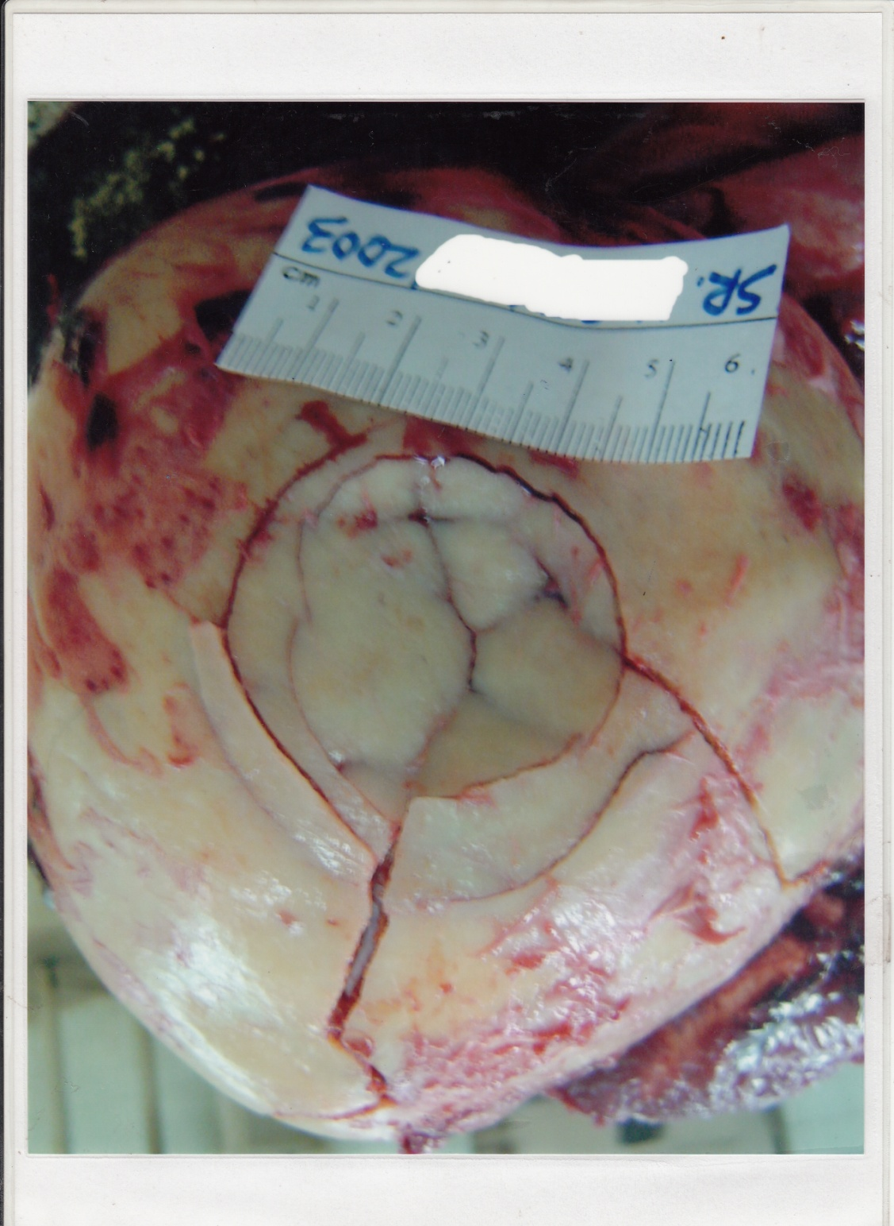
1. Describe the injury seen in this photograph.

Slide 11
1. Describe the injury seen in this photograph.
Depressed, comminuted fracture located on the left occipital region approximately circular in shape. The diameter is approximately 5 cm. maximum depression is seen at the center of the injury. There are 2 linear radiating fractures. The upper one is directed forward and upwards. Lower one is directed forward and downwards.

Slide 12
2. What are the features of the possible causative weapon.

Slide 13
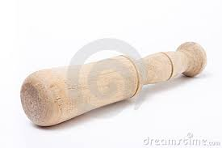
2. What are the features of the possible causative weapon.
Heavy, Blunt, Rigid weapon with a circular striking surface such as
Pestle or
Impact on a blunt object such as a stone on the ground with back ward fall

Slide 14
3. State the medico-legal significance of this injury.

Slide 15
3. State the medico-legal significance of this injury.
Category of hurt
Evidence of violence
level of force used against the victim
Interpretation of features of the weapon
Identification of the weapon
Dating of the injury as a recent injury
Event reconstruction

Slide 16

Fact file…
Skull fractures

Slide 17
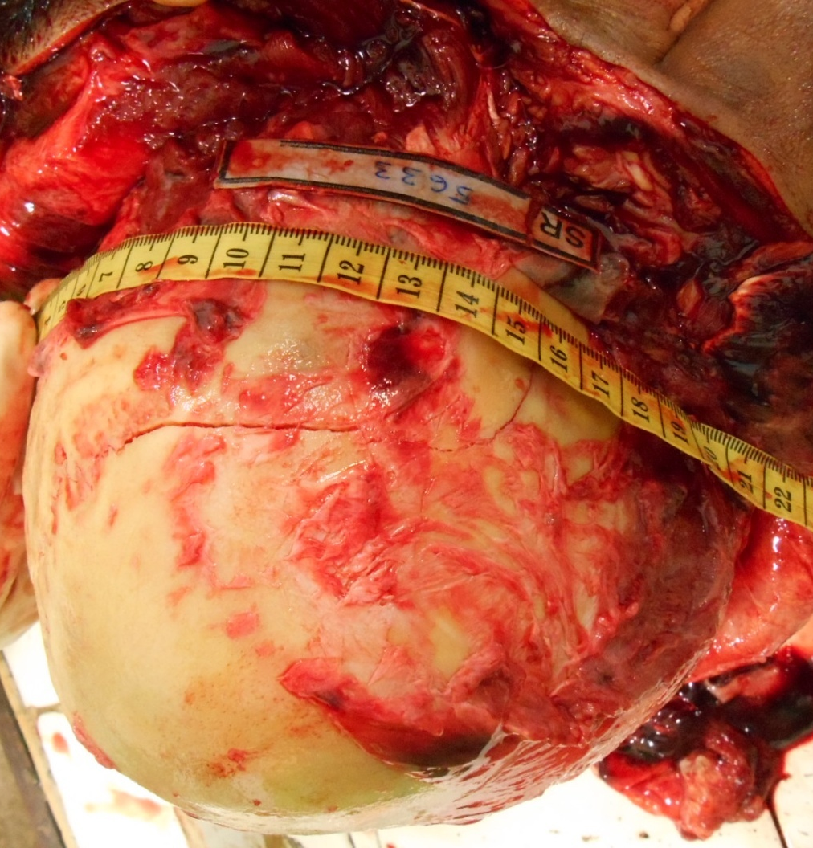
Linear fracture…
Curved or linear fractures usually present in the weaker unsupported bones

Slide 18
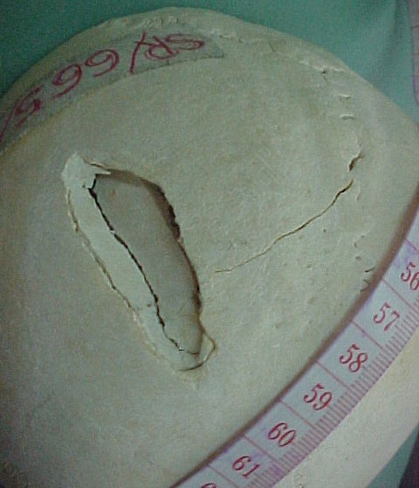
Depressed skull fracture…
Fragments of the skull table are displaced inward.
The fracture shown in this photograph shows a depressed comminuted fracture.

Slide 19
Cobweb/Mosaic or Spider’s-Web skull Fracture…
Multiple linear fractures, which are connected to each other by one or more rings of successive circular fractures .
In this photograph the cobweb fracture is also depressed.

Slide 20
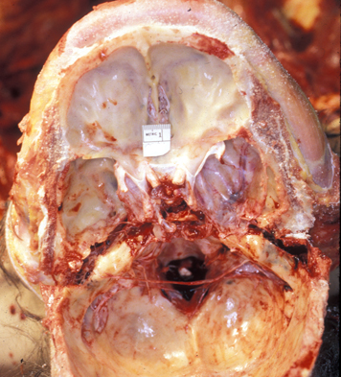
Hinge fracture…
Transverse fracture in the middle cranial fossa extending from one end to the other.
Commonly seen in motorcycle accidents.

Slide 21
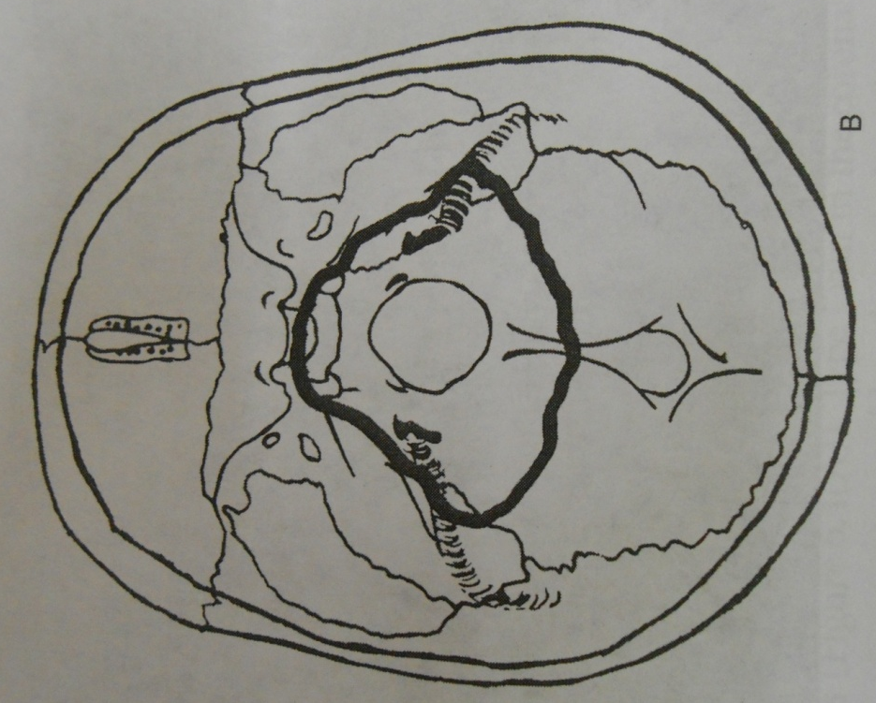
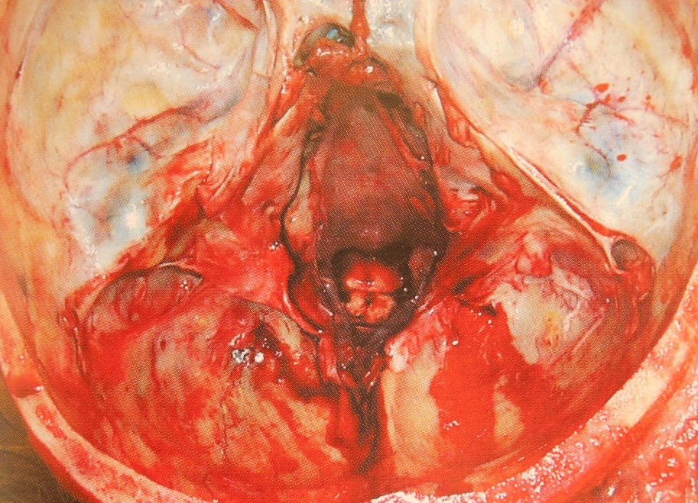
Ring Fracture
Fracture in the posterior cranial fossae, which encircles the foramen magnum .

Slide 22
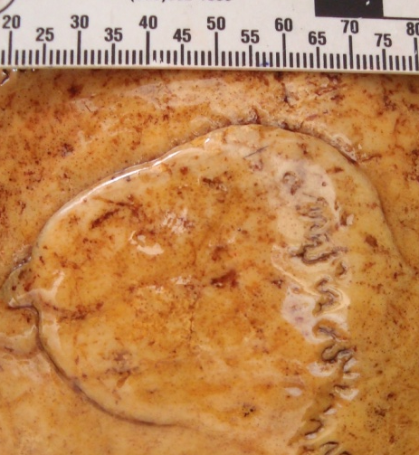
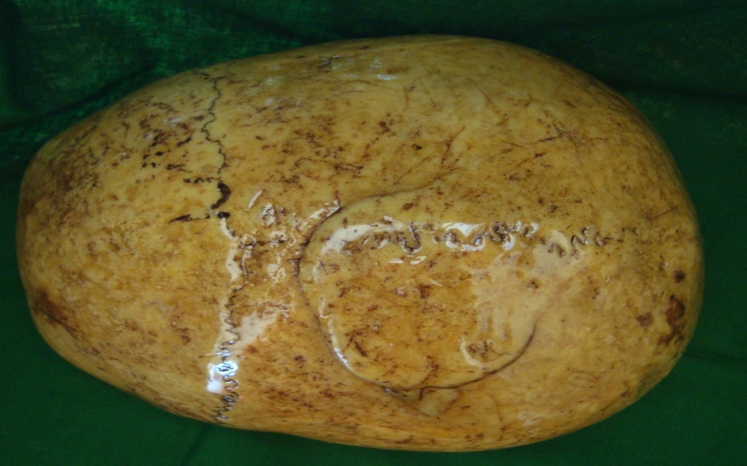
Leverage Fractures...
Fracture is elevated due to the leverage effect following withdrawal of the weapon. These are associated with cut or stab injuries.

Slide 23
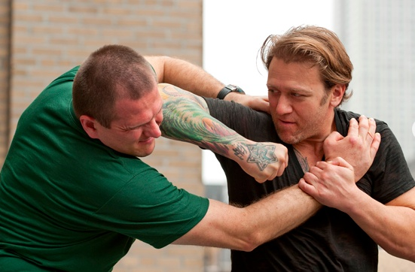
Case scenario…
This patient was admitted to a surgical ward with a history of assault. Following X ray was taken at the PCU.

Slide 24
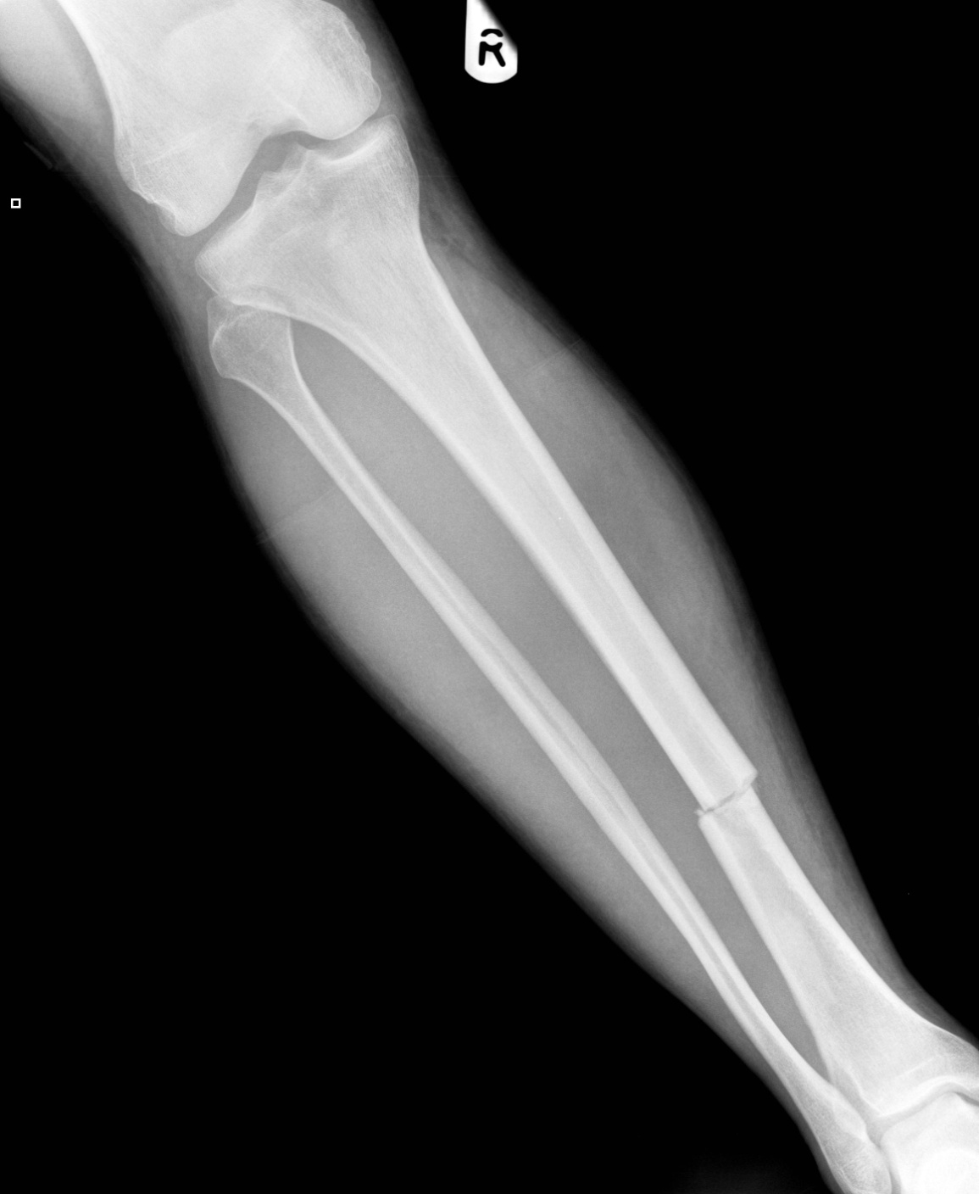
1. This x’ray shows AP view of right lower limb. Describe the injury.

Slide 25
1. This x’ray shows AP view of right lower limb. Describe the injury.
Transverse tibial fracture at the lower 1/3 of right tibia .
Minimally displaced

Slide 26
2. State how you would fill the relevant page on the Medico legal examination form related to the category of hurt

Slide 27
2. State how you would fill the relevant page on the Medico legal examination form related to the category of hurt .
Category of hurt
Fractures are grievous injuries under the limb (g) according to the section 311 of penal code.

Slide 28

Summary…
Fracture is a discontinuation of the continuity of a bone. Presence of a fracture makes an injury grievous.

Slide 29
YES! You Can!

Slide 30

GOOD JOB!

